Slide 1

Comparing to human-level performance
Avoidable bias
deeplearning.ai
Notes:
1.不希望他做的太好

Slide 2
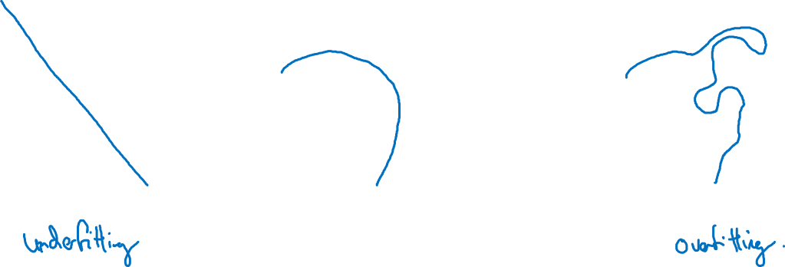
Bias and Variance
high bias
“just right”
high variance

Slide 3
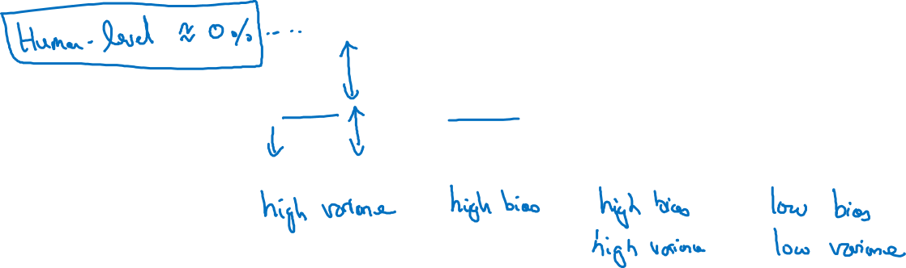
Bias and Variance
Cat classification
Training set error: 1% 15% 15% 0.5%
Dev set error: 11% 16% 30% 1%

Slide 4
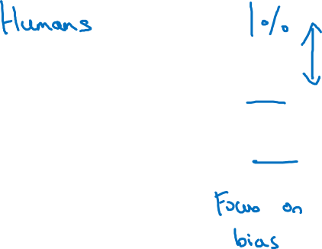
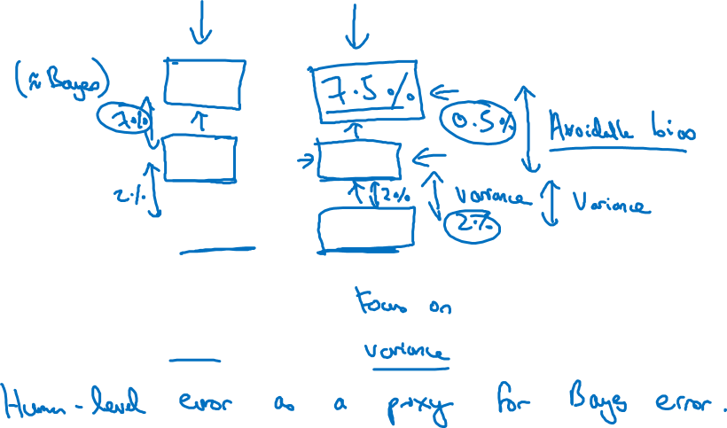
Cat classification example
Training error 8%
8 %
Dev error 10%
10 %
Notes:
左边的应该注重bias
右边的注重8%到10%之间的gap：variance
这里假设的是bayes error = 0%
但是，人类的错误human-level error才应该是bayes error的proxy（因为应该以人的判断为标准）
所以右图的avoidable bias是8-7.5 = 0.5

